Slide 1
My Cute Cats
By David Leng

Slide 2


Our journey starts when this strapping lad
Met this beautiful young lady
One day, they decided that they wanted to start a family.
And fate would have it…

Slide 3
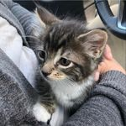
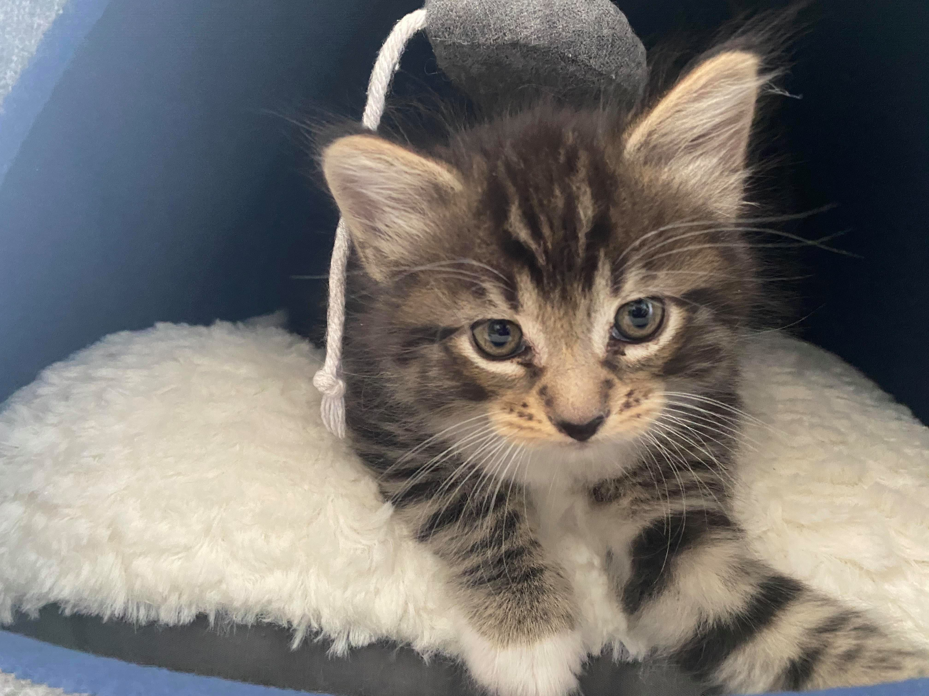
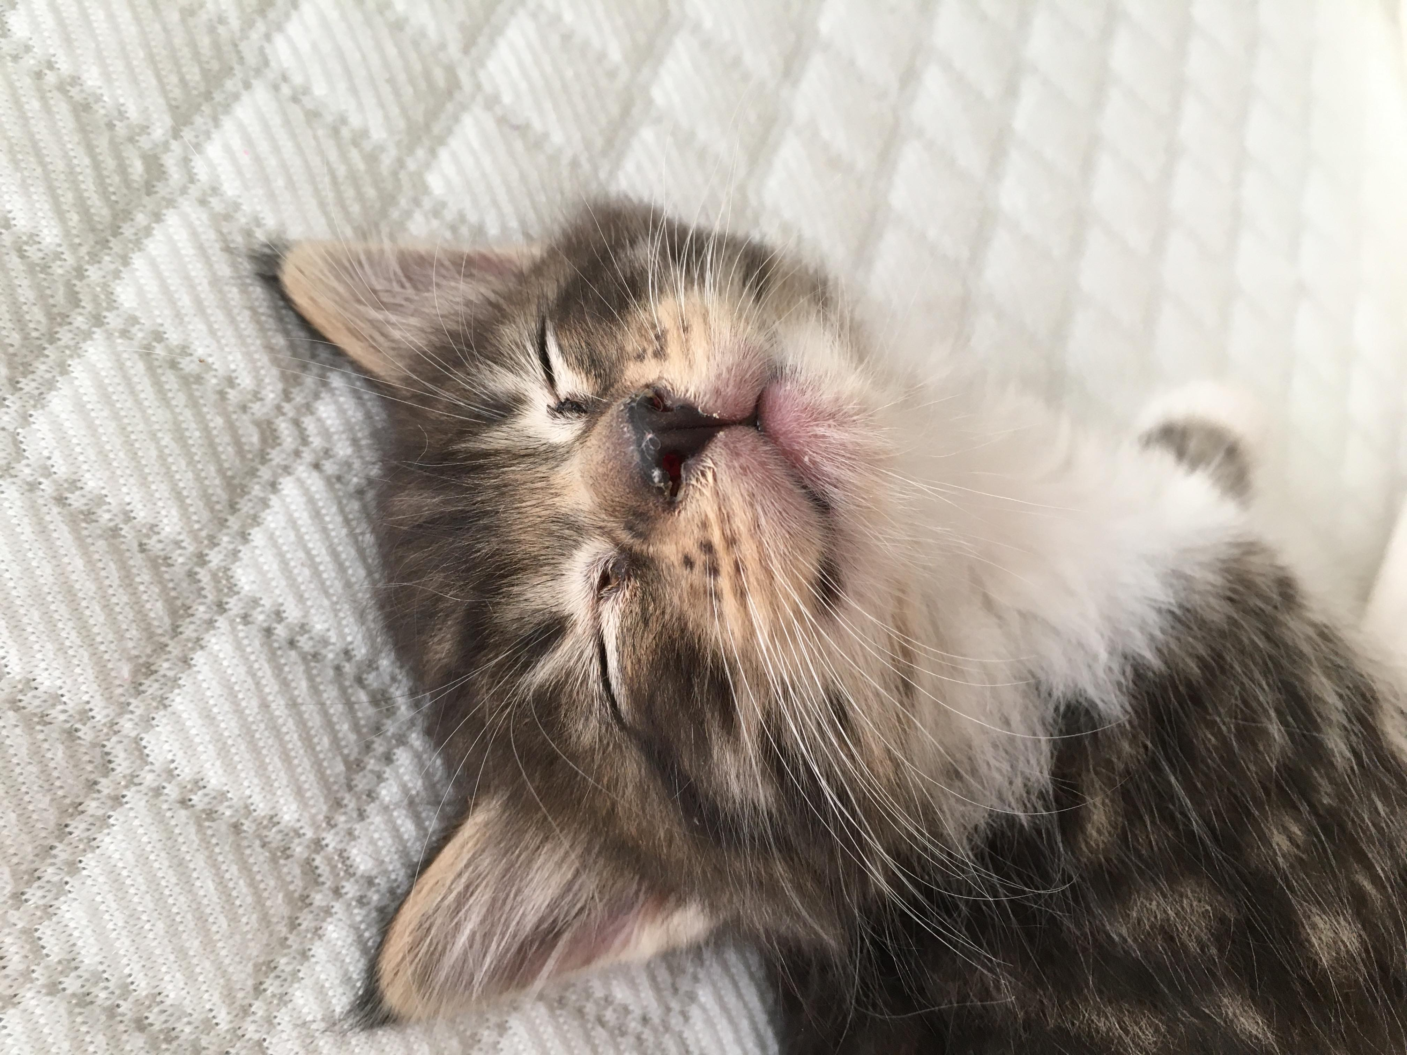
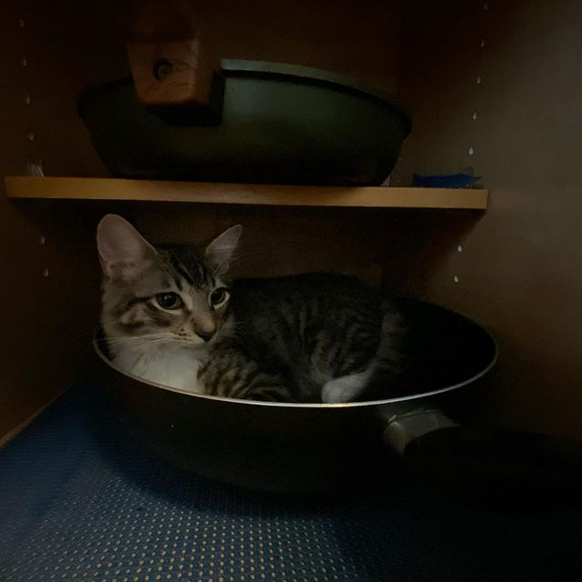
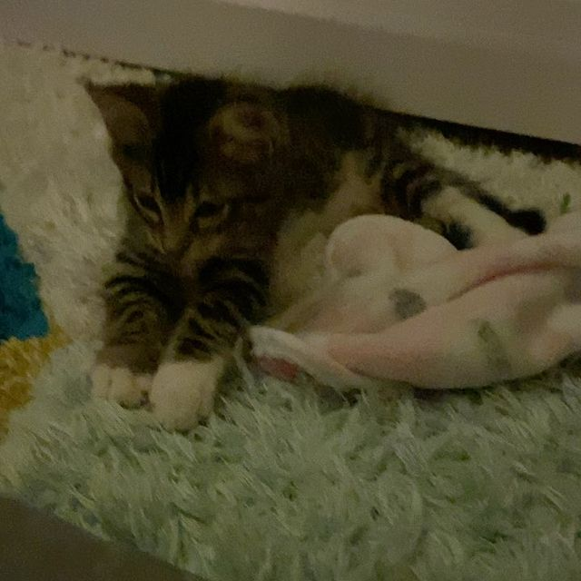
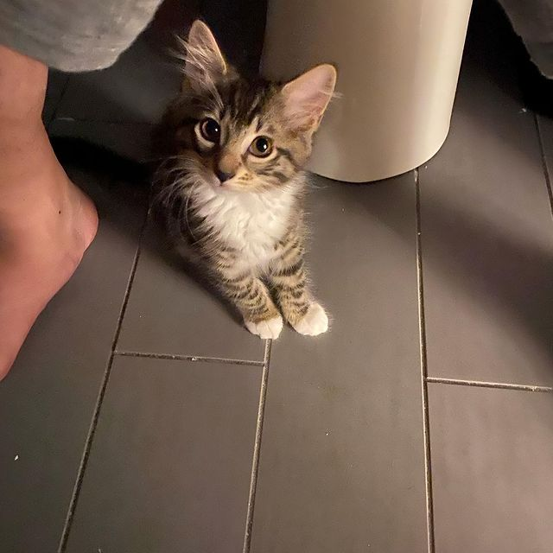
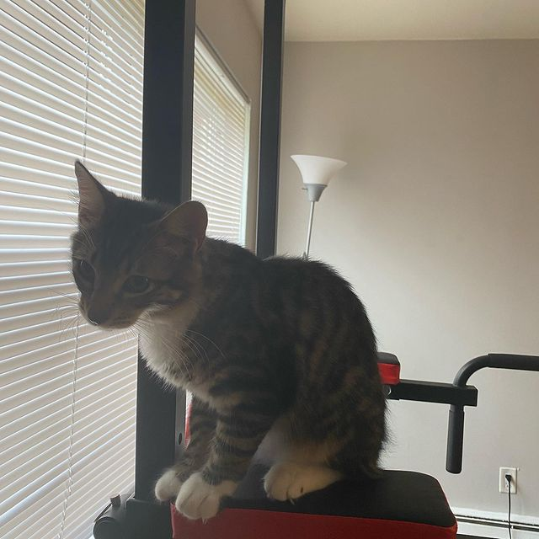
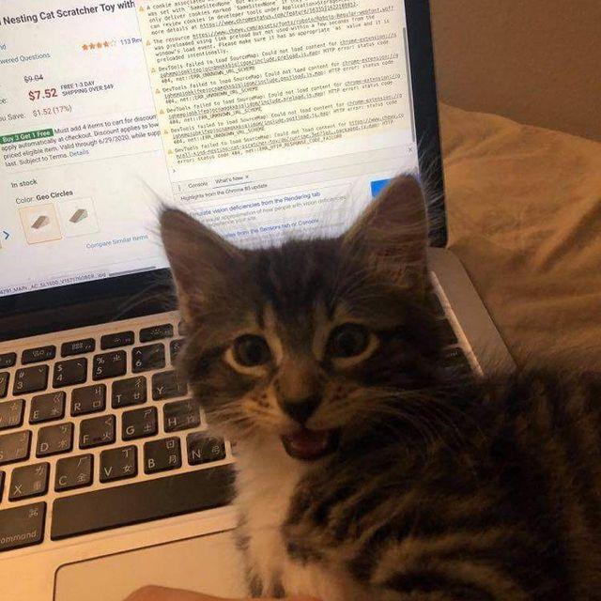
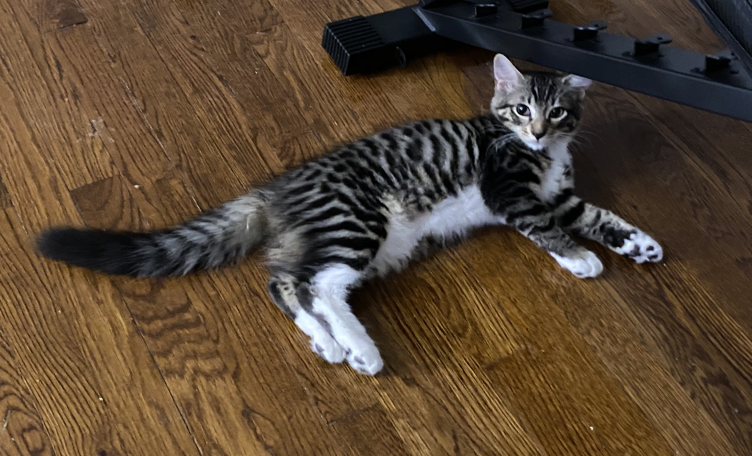
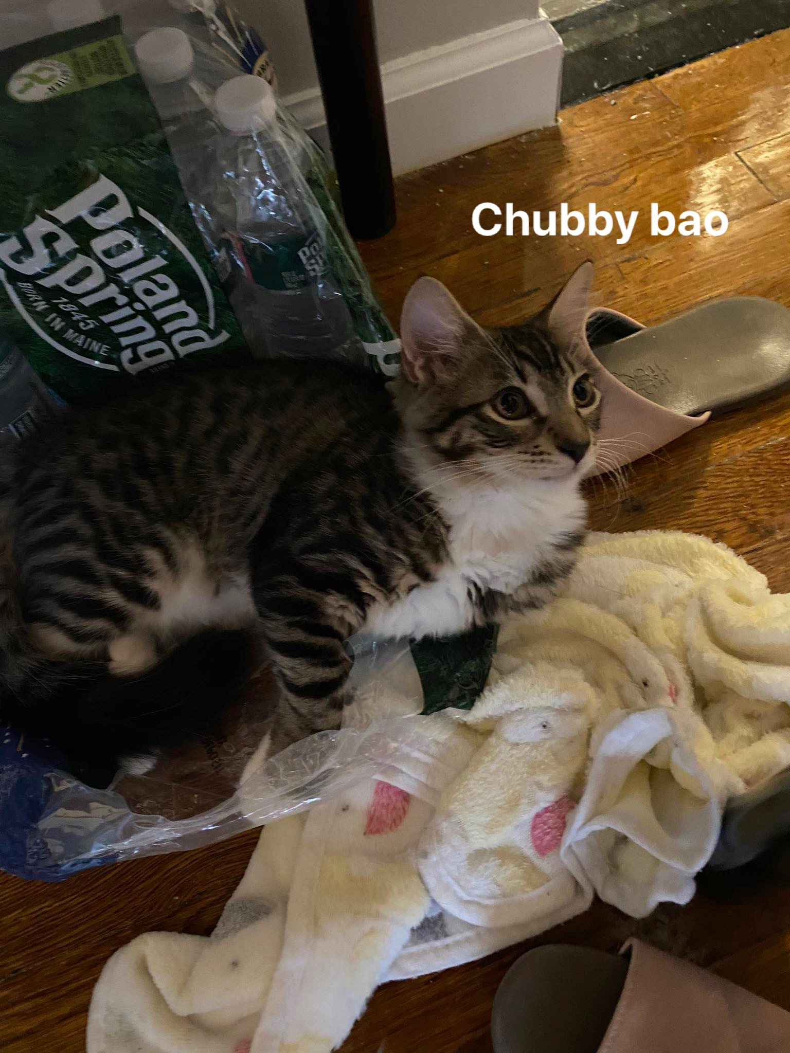
They met BaoBao!

Slide 4
At the ripe age of 3 weeks,
he was a bit shy at first

Slide 5
But he slowly became a very good boy

Slide 6
He enjoys culinary

Slide 7
Making biscuits

Slide 8
Being cute

Slide 9
Climbing

Slide 10
Computer Science
and much more!

Slide 11
However, over time we noticed that he would get lonely

Slide 12
And perhaps a parent’s love was not sufficient especially during the times we were not home

Slide 13
What was a parent to do?
After spending some time researching the local shelters, we finally found her.

Slide 14
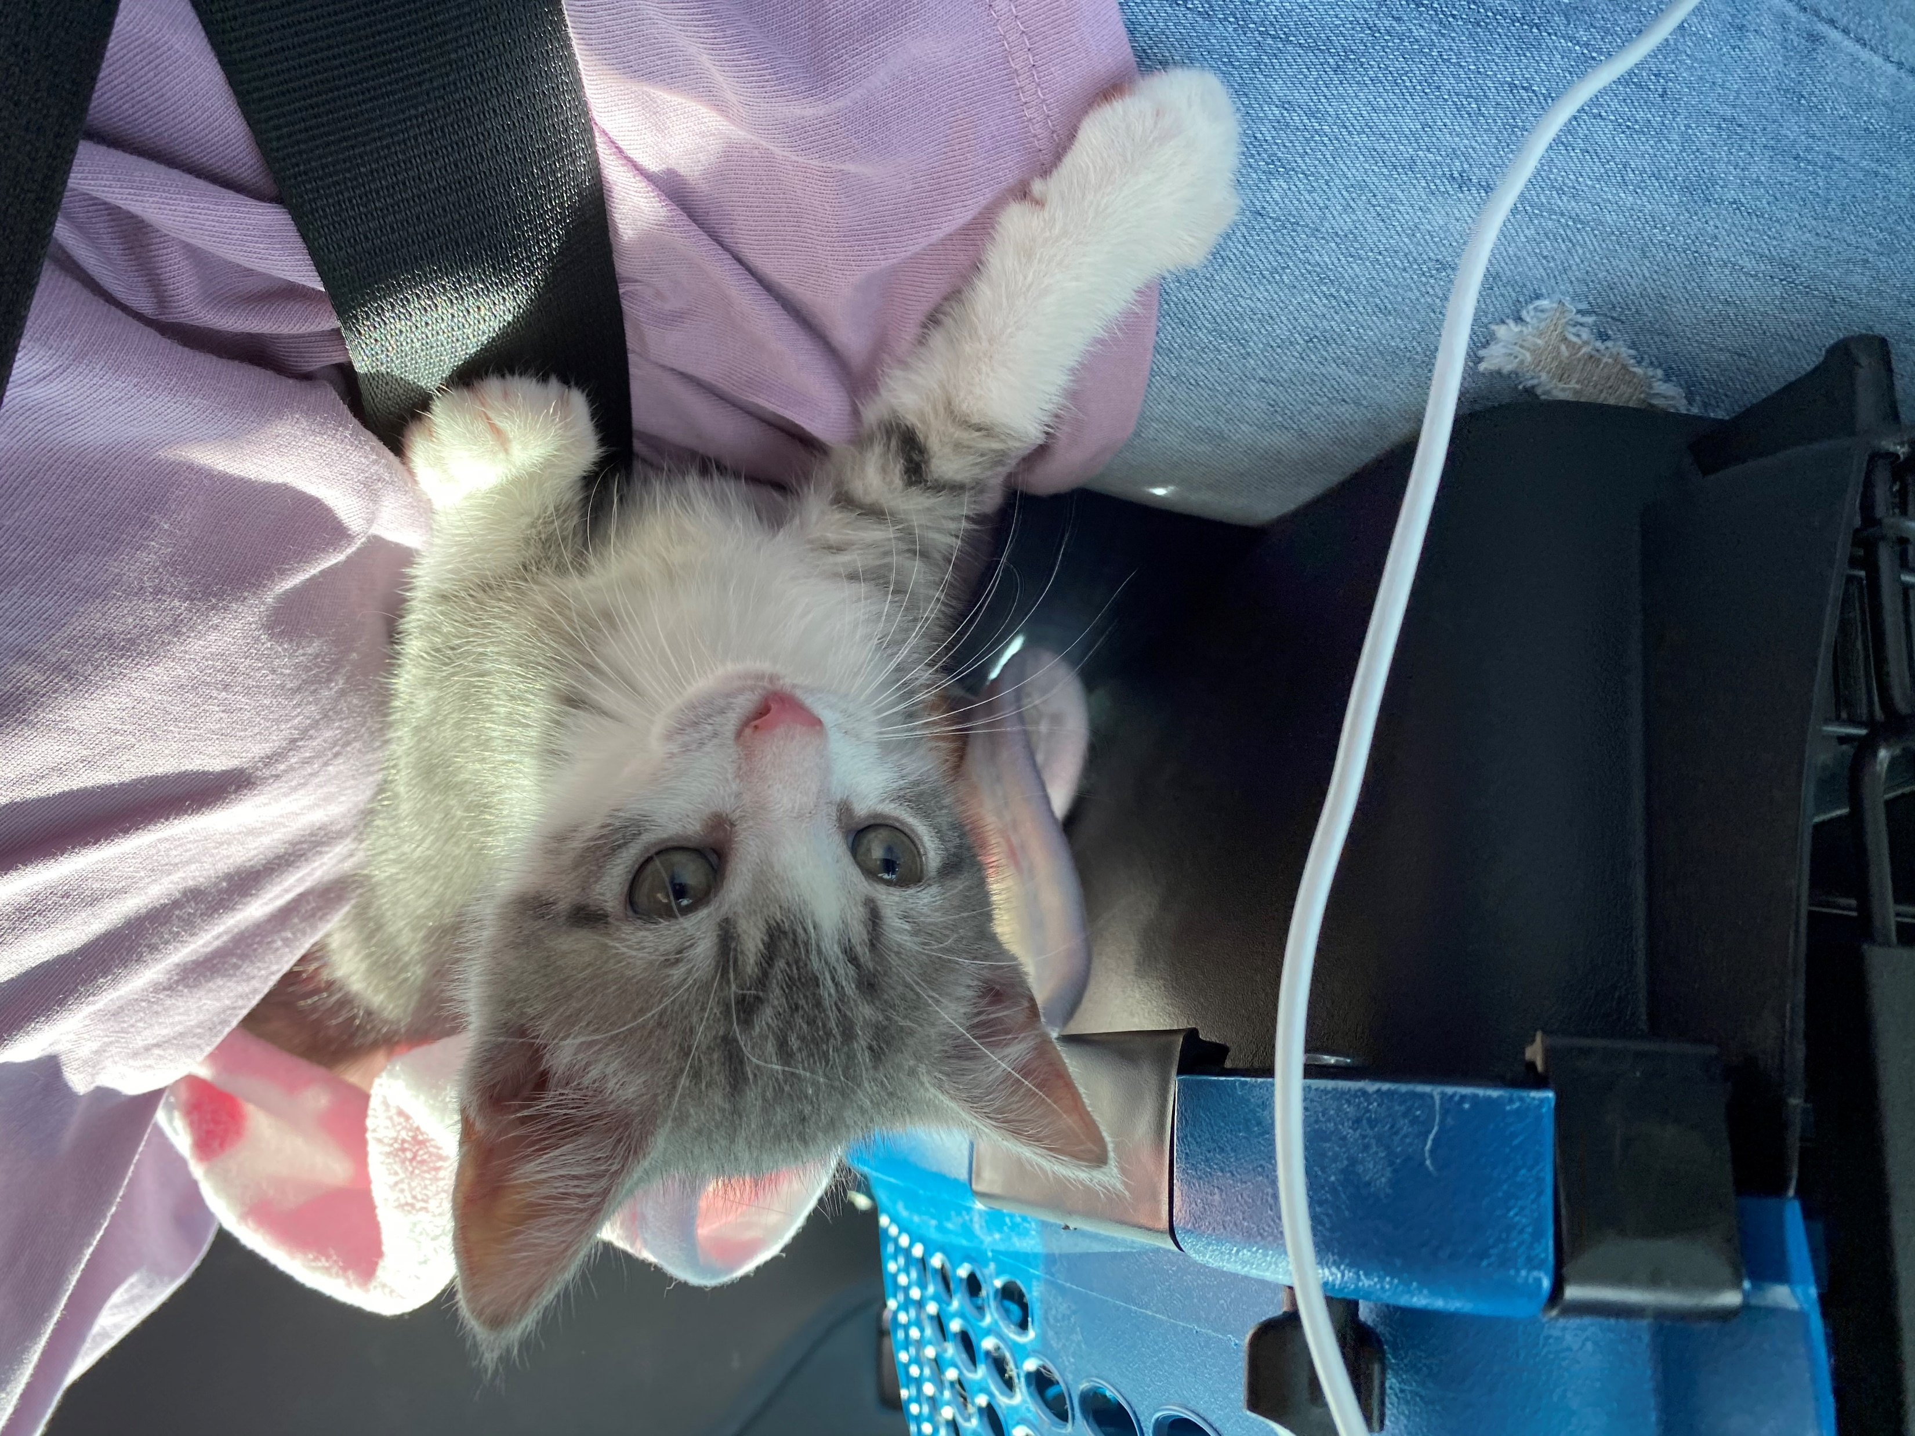
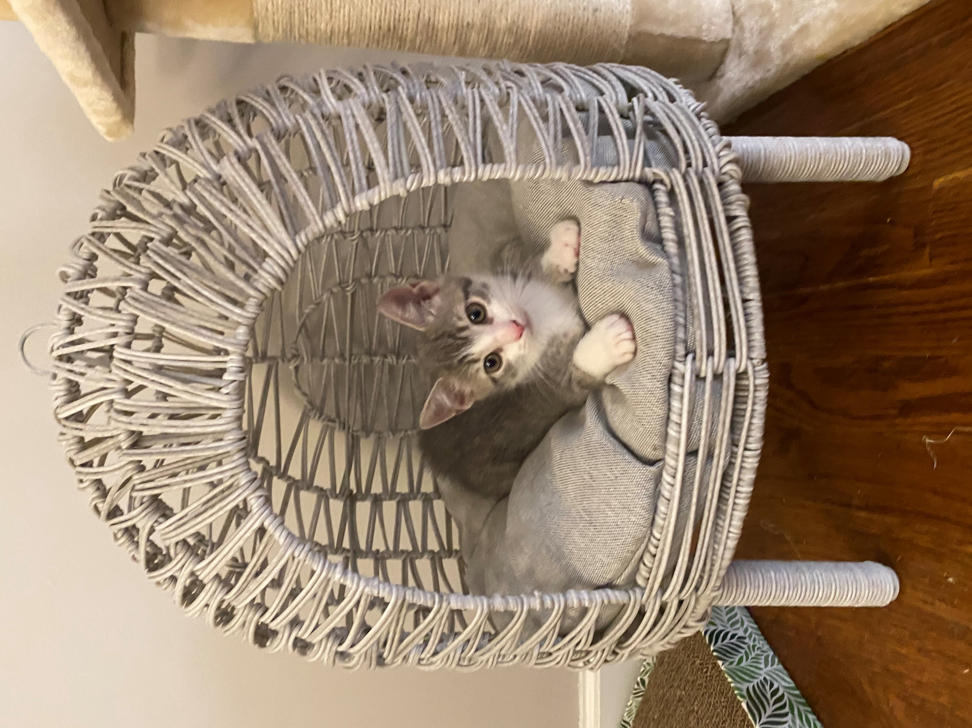
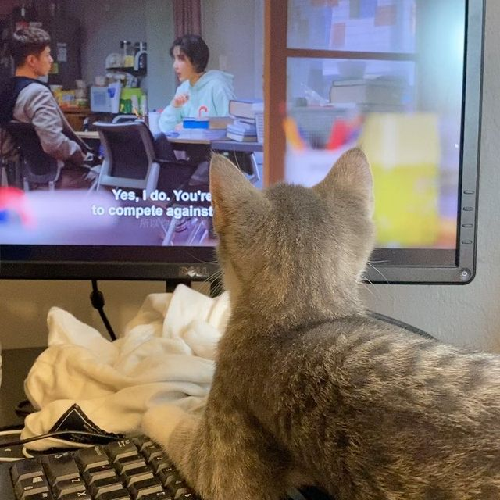
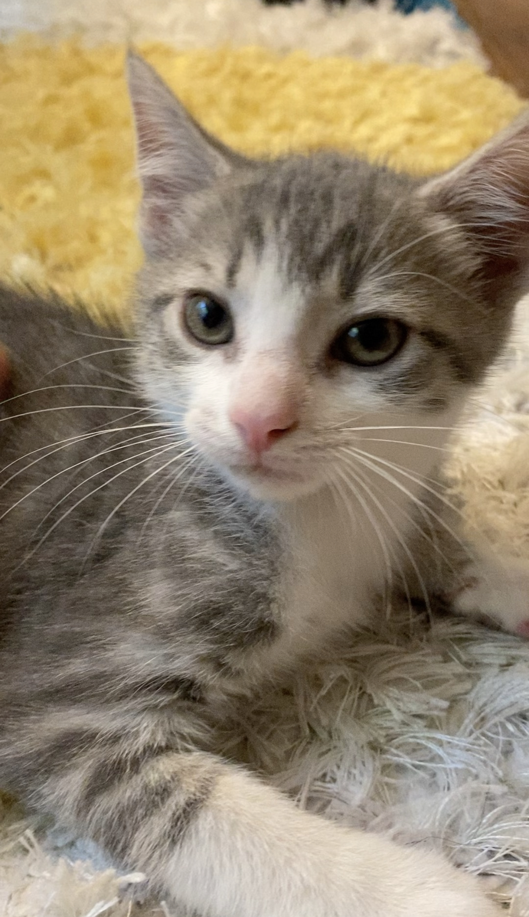
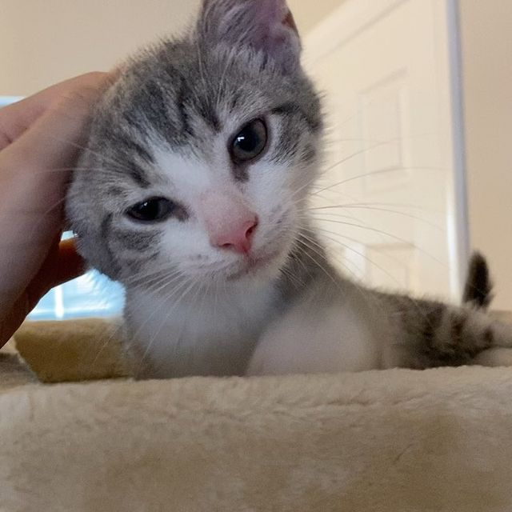
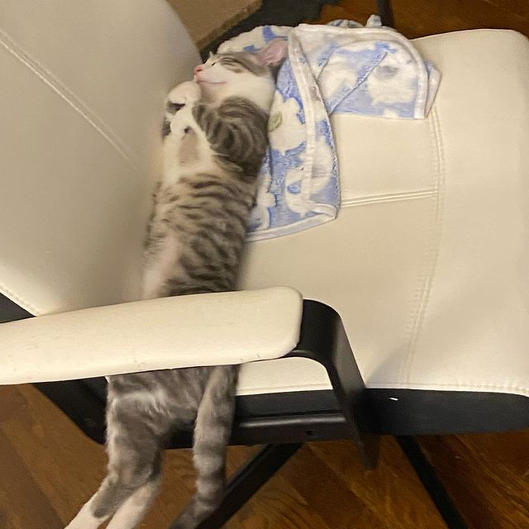
Meet Millie!

Slide 15
She’s super cute

Slide 16
Enjoys watching K-Drama

Slide 17
Purring loudly

Slide 18
Head rubs

Slide 19
and acting like a
little human ☺

Slide 20
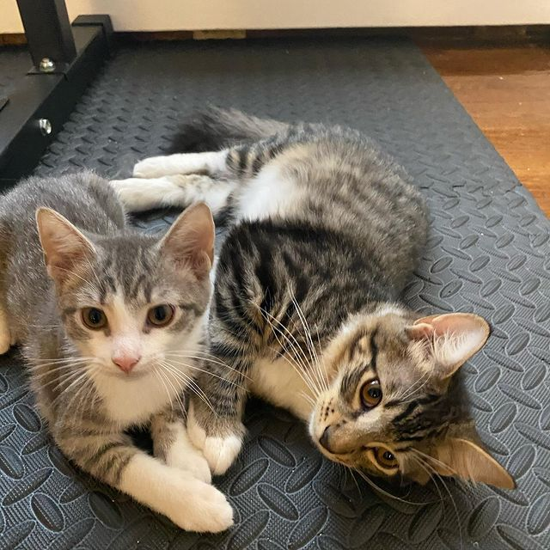
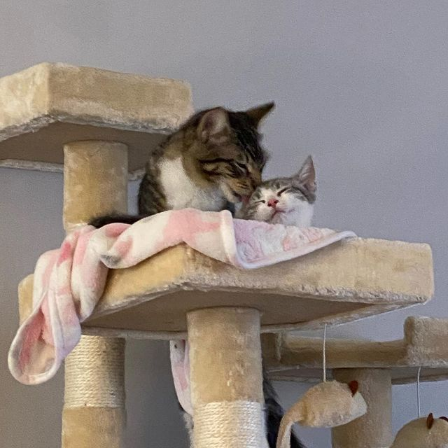
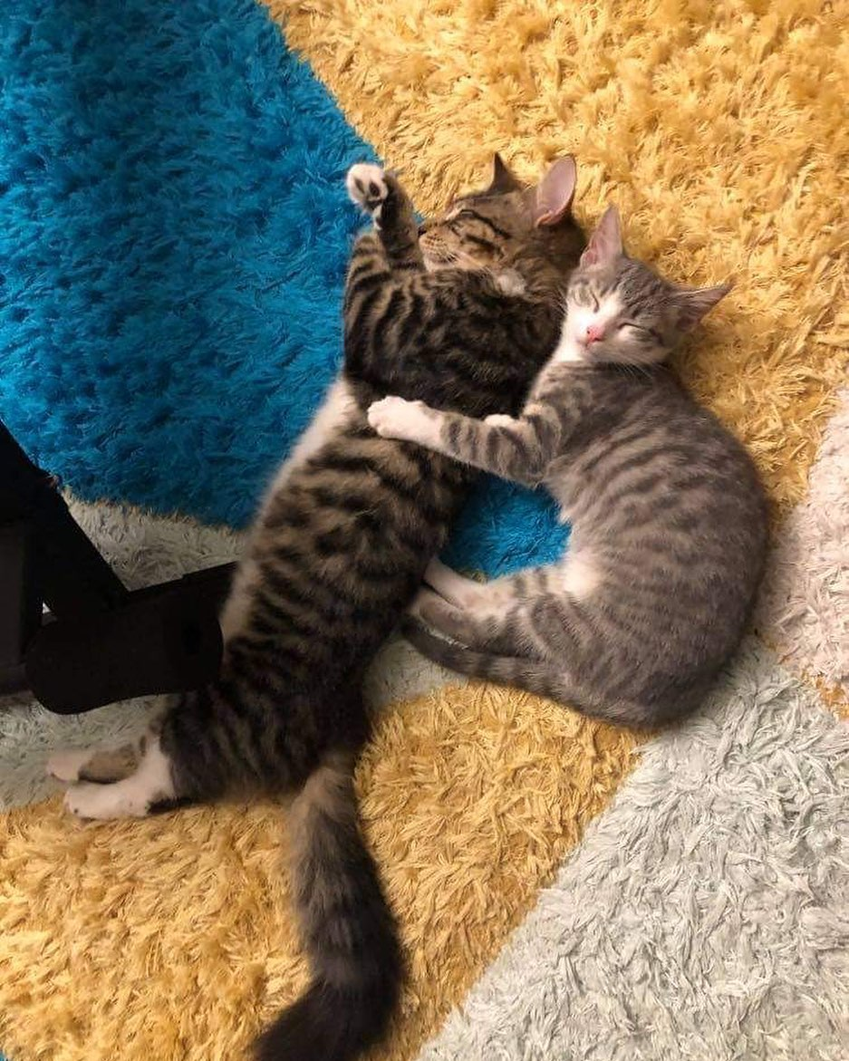
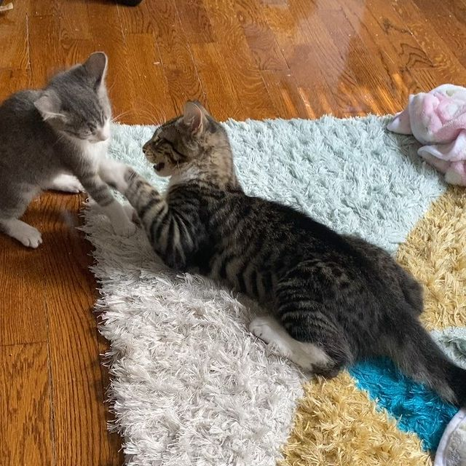
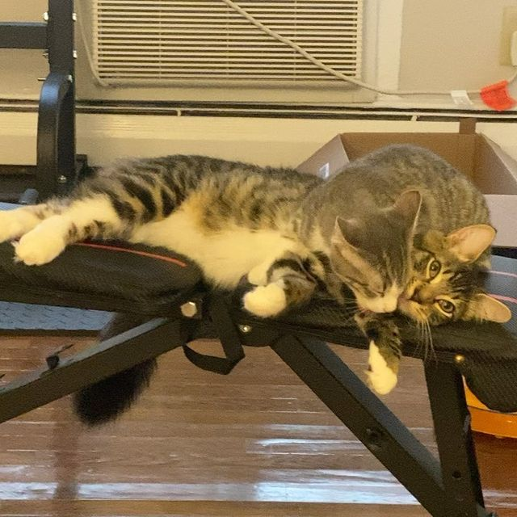
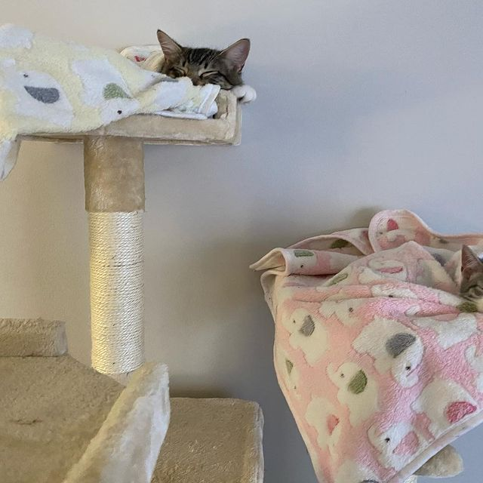
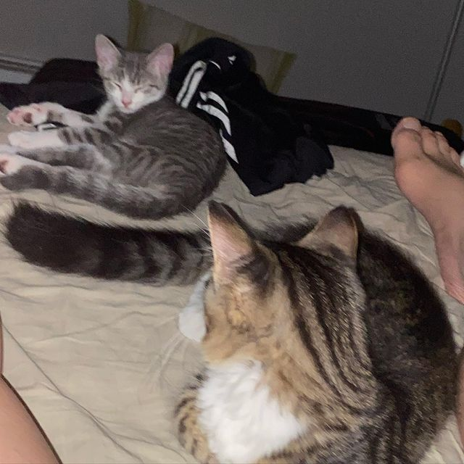
These two have been inseparable since they met

Slide 21
In the beginning of their relationship BaoBao was always watching over Millie

Slide 22
Over time you can see who is the real top cat

Slide 23
Sometimes they would
fight

Slide 24
Sometimes she would
annoy him

Slide 25
At the end of the day, you can see how close they are

Slide 26
And at the end of my days, I am no longer able to move my feet freely after falling asleep

Slide 27
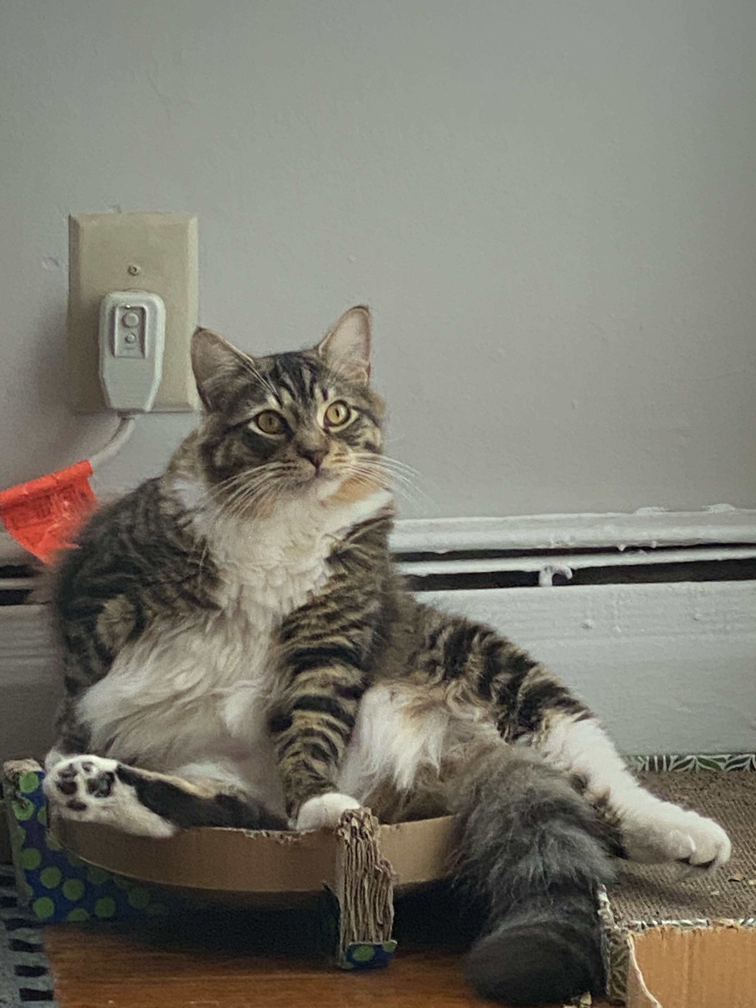
Thanks for checking out my kids. Here’s a bonus for sticking around!
“When the President declares the pandemic is almost over and you’re still not beach body ready🙀”

